Slide 1
CS 484 Final Project Adult Data set
Kevin Pfeifle & Nolan Meeks
Notes:
Nolan

Slide 2
Description
Based off Adult Data Set from UCI Machine Learning Repo.
1994 census data – Determining whether or not a person’s income exceeds $50,000 dollars a year
48,842 instances – 14 Attributes + income label
Age, Workclass, Fnlwgt, Education, Education-num, Marital Status, Occupation, Relationship, Race, Sex, Capital-Gain, Capital-Loss, Hours-Per-Week, Native-Country
Some attributes are continuous, while some are categorical
The training data is unbalanced, roughly a 25/75 split favoring smaller income
Notes:
Kevin

Slide 3
Pre-Processing
Don’t just dive into code…see what’s out there
Can’t simply pass continuous & categorical data to classifiers!
Need to find a way to encode somehow
Pandas!
Formatted the data to csv
Removed unnecessary/irrelevant attributes
Notes:
Kevin

Slide 4
Data Preparation
‘Popped’ Income column for the Labels arrays
Updated thresholds in-place to be 0 for <=50K and 1 for >50K
Difficult trying to encode continuous data alongside strings (categorical part)
Pandas extremely helpful
Get_Dummies!
One last error to fix…DataFrames were different shape!
testFeatures[censusTrain.columns.difference(testFeatures.colums)[0]] = 0
Now we can align the column order and begin the Classifiers
Notes:
Nolan

Slide 5
Classification
Decision Tree Classifier
Had to be careful of overfitting…can’t prune with scikit-learn, need to use max_depth
Naïve Bayes
Don’t forget undersampling!
K-Nearest Neighbors
Tried with several K-values to compare, performed generally quite well
Support Vector Machine
Typical cross validation had a wonderful variety of issues and complaints against the shape and differences between the shapes of our Data at this point
Used sklearn.metrics.mean_absolute_error(testLabels, classifier.predict(testFeatures) to get an error rating
Notes:
Kevin

Slide 6
Results
1st Place: Support Vector Machine with ~87% Accuracy!
2nd Place: Decision Tree Classifier (with ‘manual’ pruning) with ~86% Accuracy!
3rd Place: K-Nearest Neighbors (K = 5) with ~85% Accuracy!
4th Place: K-Nearest Neighbors (K = 3) with ~84% Accuracy!
5th Place: K-Nearest Neighbors (K = 1) with ~82% Accuracy!
6th Place: Naïve Bayes Classifier with 76% Accuracy!
Attempted to work with this but couldn’t get better ratings
Notes:
Nolan

Slide 7
Some further analysis…
Found a strong correlation between hours per week working and education completion with respect to the income.
Can see on graph on next slide…
Hard to make different comparisons like this, need to have a legitimate reason to believe X & Y axis had a relationship first, then compare that against the income thresholds to see if it had any real effect.
Data had some strange entries…many very young people apparently married, or making a lot of money. Provided confusion at times.
Notes:
Nolan

Slide 8
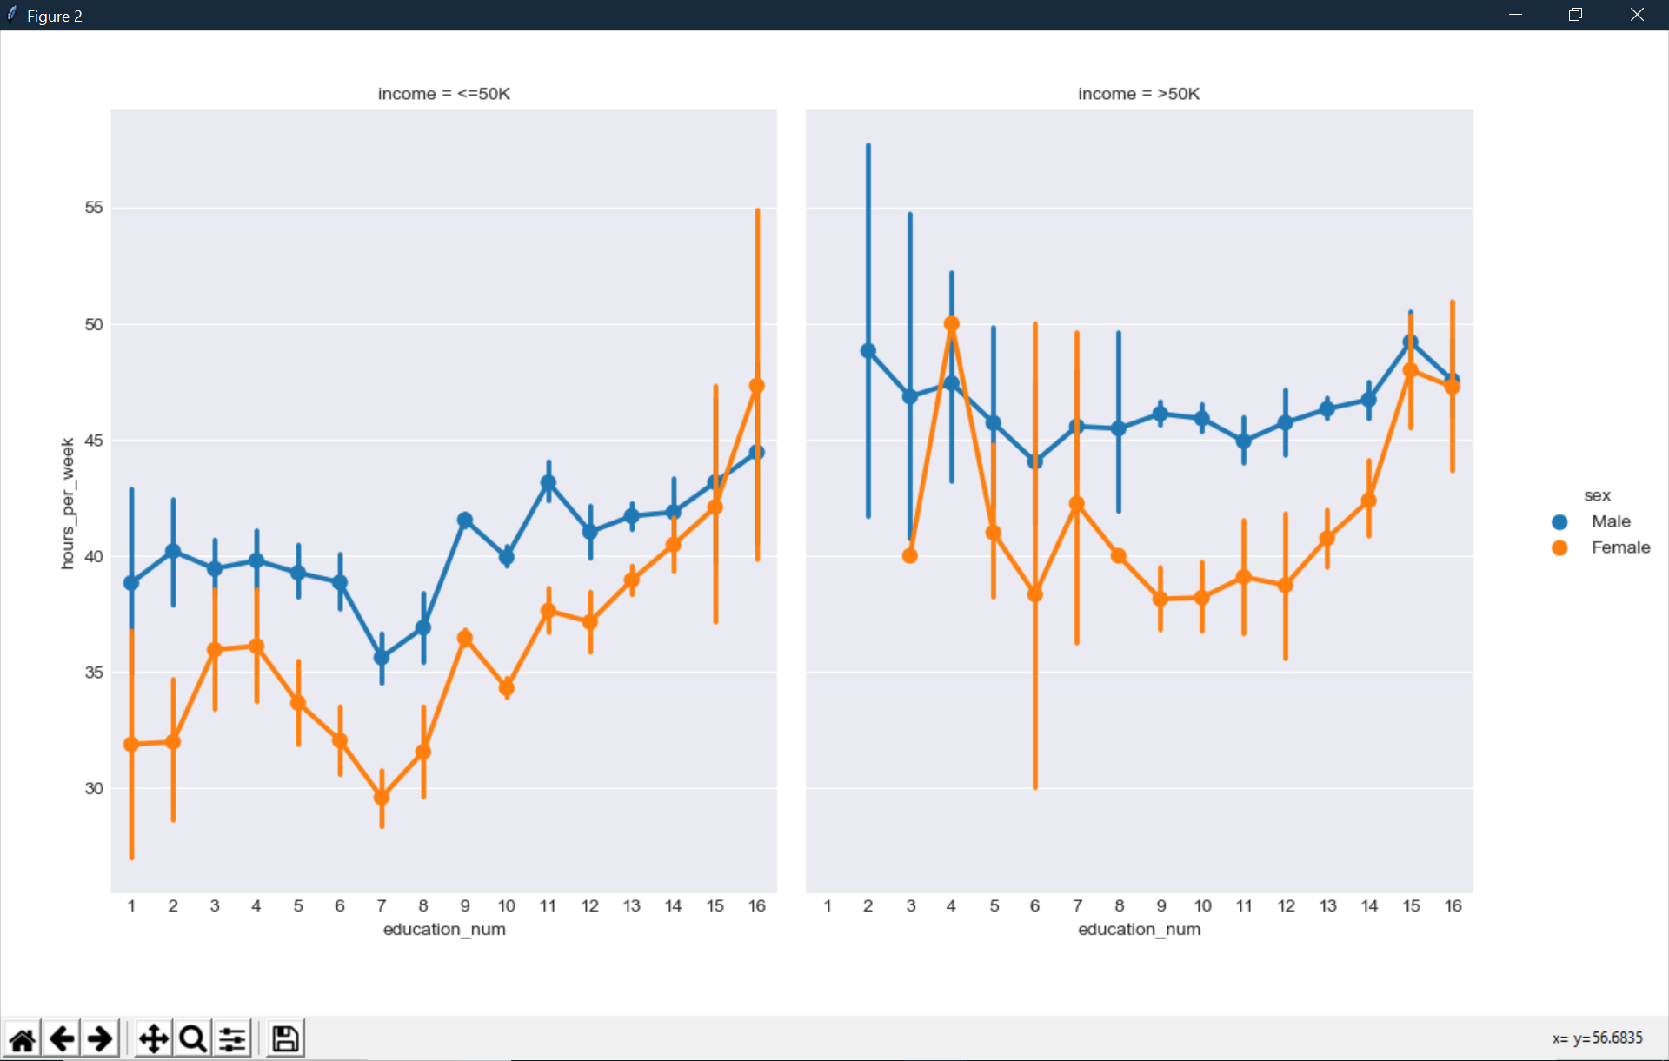
Notes:
Nolan

